Slide 1
Chapter 5
Networking Devices

Slide 2
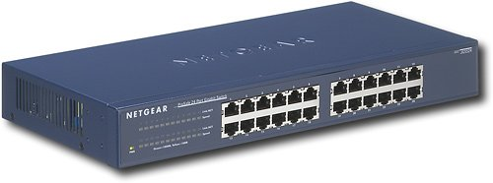
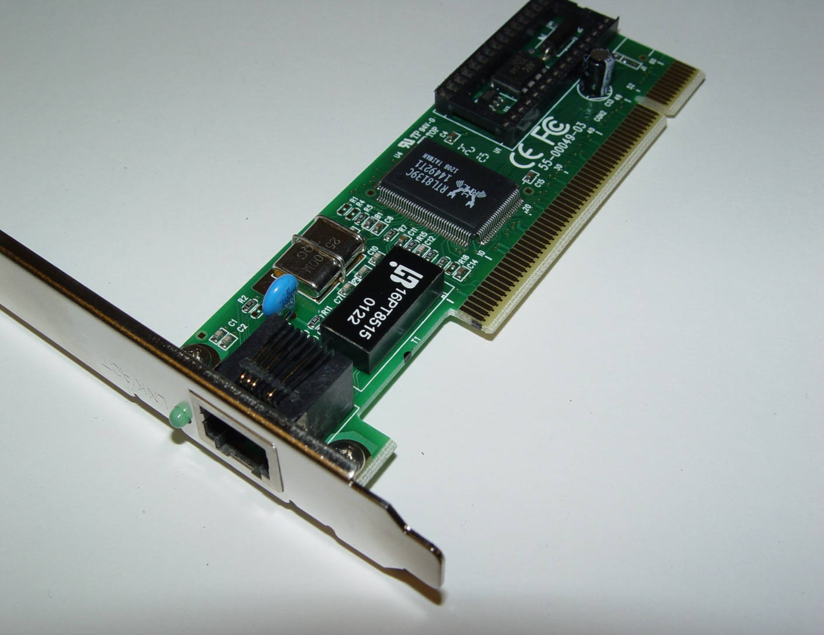
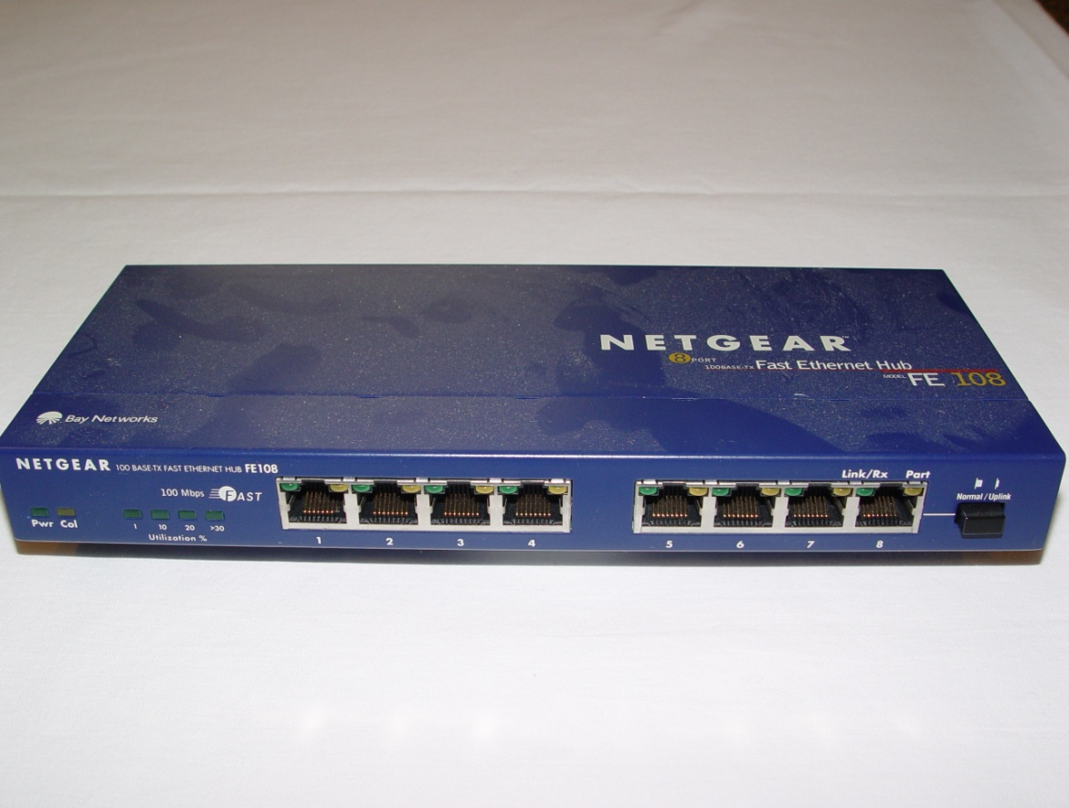
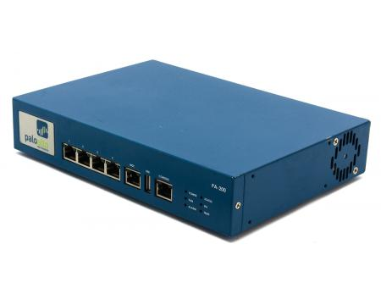
Networking Devices
Network Interface Card (NIC)
HUB
Bridge
Switch
Router
Firewall
IDS/IPS
Notes:
NIC: provides the physical, electrical, and electronic connections to the device
It’s a layer 2 device because it communicates using the MAC address
Hub: It has no intelligence, it is a layer 1 device, a hub simply repeats all data to all hosts on the network
Hubs are glorified repeaters
Bridges: main purpose is to break up collision domains, they use MAC addresses to make forwarding decisions so they are layer 2 devices
Switch: Are intelligent hubs because; it pays attention to frames, source and destination MAC addresses, and knows which port data has been received. Layer 2
Switches use MAC addresses to make forwarding decisions
Router: They process routing packets. Use IP addresses to make forwarding decisions, so they operate at layer 3
Firewall: Act as security guards for your network. It filters packets based on rules that have been implemented to determine what data is allowed to flow in and out of your network.
Firewalls operate at multiple levels of the OSI model depending on the rules in place
IDS: It monitors, records problems, and tells you about it
IPS: Works in real time to stop the threats

Slide 3



Firewall
Internet
Internal Network
Firewall
DMZ
Firewall
Notes:
A firewall can be a box or a software placed on a server or router
Two network connections within a firewall; internet side and one on the network
A DMZ is another type of private firewall, also called a screened subnet. that is within the network that
Example would be you having a website for your organization hosted on a web server, but you don’t want users to have access to your internal network

Slide 4
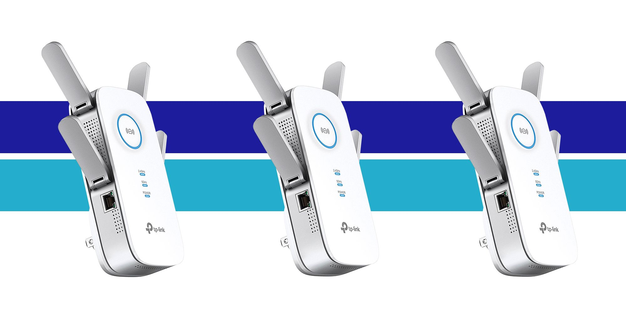
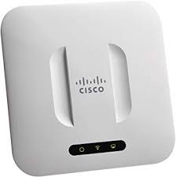
Networking Devices Cont.
Access Points
Range Extenders
Notes:
An access point is just a wireless hub via analog wireless signals and they operate at Layer 2
A range extender does exactly what it sounds like, it can extend the wireless signal from your router to other parts of a building or room

Slide 5
Contention Methods
Carrier Sense Multiple Access
Collision Detection
Collision Avoidance

Slide 6
Network Servers
Dynamic Host Configuration Protocol
Assigns
IP
Subnet Mask
Default Gateway
Domain
DNS Servers
DHCP Relay on a ROUTER
IP Address Management (IPAM)- Software that manages both DNS and DHCP
Notes:
DHCP assigns IP addresses to hosts.
It assigns it automatically
The server is configured with a pool of addresses that is can use and has a list of addresses that are “off limits”
DORA: Discover, Offer, Request, Acknowledge
The computer/client sends out a DCHP discover message
The DHCP server responds with an offer of IP address options
The client makes a request for an IP address
The DHCP server acknowledges the request and the cycle is complete
IP addresses have lease terms and it also allows you to reserve static addresses
A DHCP relay, since routers cant forward broadcasts, the relay agent sends out the request message from its own IP address to get the IP address for the client
The reason for this is DHCP sends out broadcasts and routers won’t forward broadcasts
IPAM integrates the management of DNS, DHCP, and IP addresses

Slide 7
Other Devices
Multi-Layer Switch
Layer 3 Switch
Load Balancer
Domain Name Server
FQDN
Record Types
Proxy Server
Encryption Devices
Notes:
A multi-layer switch or “smart switch”: It operates like a regular switch at layer 2, but it also routes traffic at layer 3 while providing up to 24 collision domains
Looks exactly the same as the layer 2 switch
DNS: makes the internet user friendly
FQDN: consists of the hostname and domain name
Record Types: also called zone files are text files that store information about a domain’s or hostname IP address
CNAME: Alternative web address; mail.google.com/google.com
Proxy Server: Operates at layer, it receives traffic and forwards traffic to the correct server; sort of filter before traffic hits the resource server
Web proxy server will cache info, like when you go to google.com again, instead of going to the google web server, your data will be pulled from the proxy server
Encryption devices: help assist with keeping your data and communications secure, but everything is hackable

Slide 8
Other Devices
Analog Modem
Packet Shaper
VPN Concentrator
Media Converter
Fiber to Ethernet
VOIP PBX
Private Branch Exchange
Notes:
Analog modem: converts digital signals that can be sent over phone lines and vice versa
Packet Shaper: Network performance management tool, allows you to control traffic, measure it, and apply Quality of Service to your network
VPN concentrator: A device that creates and helps manage multiple VPN connections remotely
Companies use these to allow remote workers to connect to the corporate network
Media Converter: the device used to convert one type of cabling to the other
VOIP PBX: PBX allows companies to have 1 or 2 outside numbers, but 50+ internal phone numbers or extensions
This adds the functionality of a PBX over traditional phone lines to work with VOIP
Rarely are people using actual phone lines anymore, most phone calls at companies occur over the network

